Slide 1



Cloud Analytics
Lima
Dennys Mallqui
MSc Computer Science - IA
Federal University of São Carlos – Brazil
Laboratório de Inteligência Artificial Aplicada

Slide 2

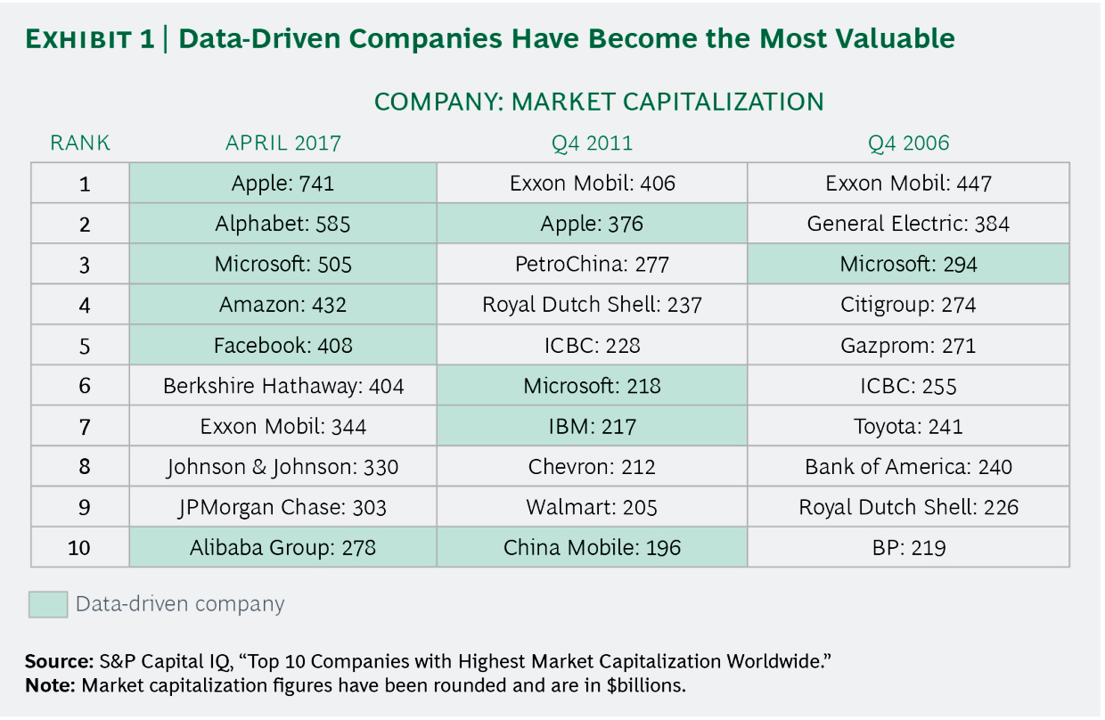
Why Analytics?

Slide 3
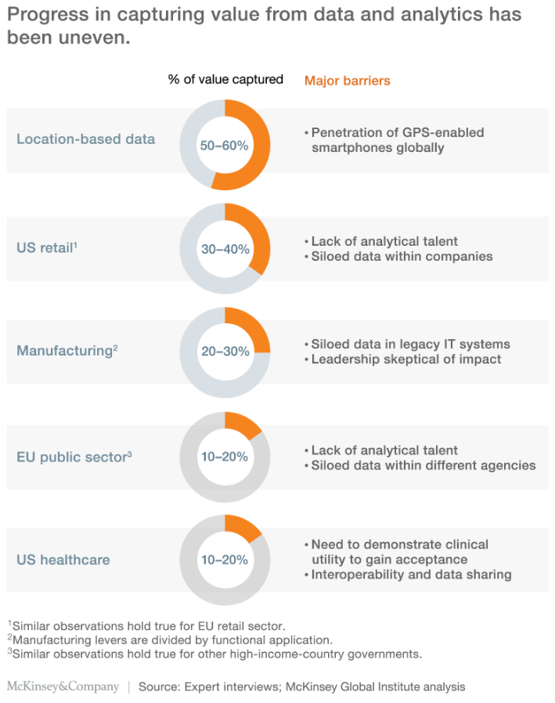
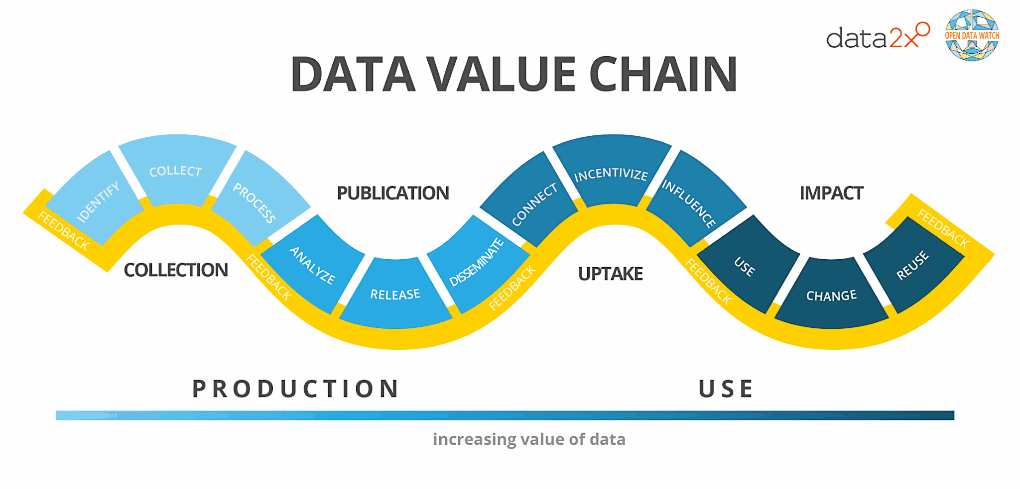
Progress in capturing value from data

Slide 4
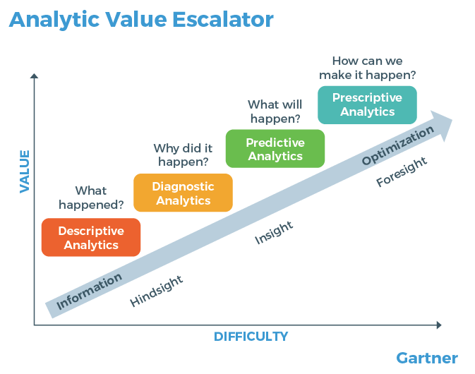
Value of Differing Types of Analytics

Slide 5
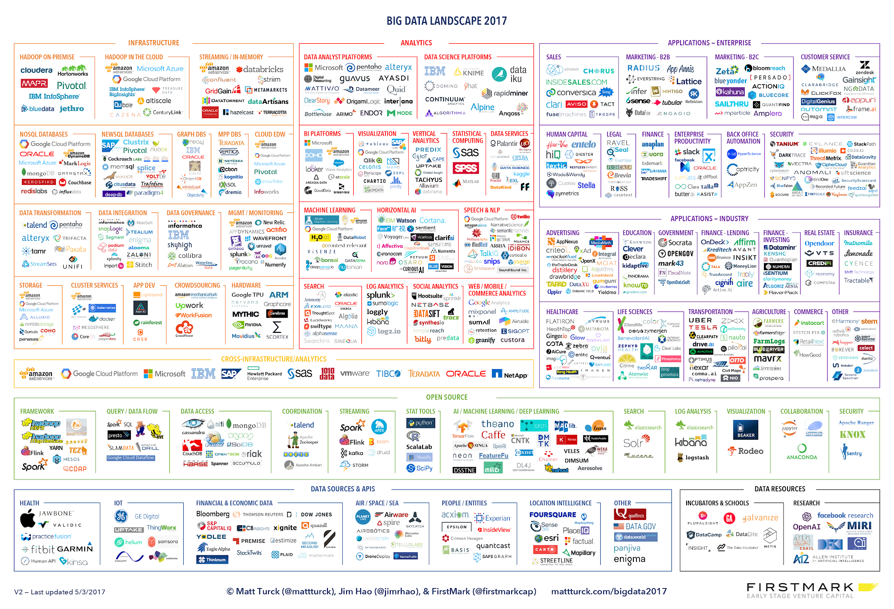
Big Data & Analytics Landscape

Slide 6
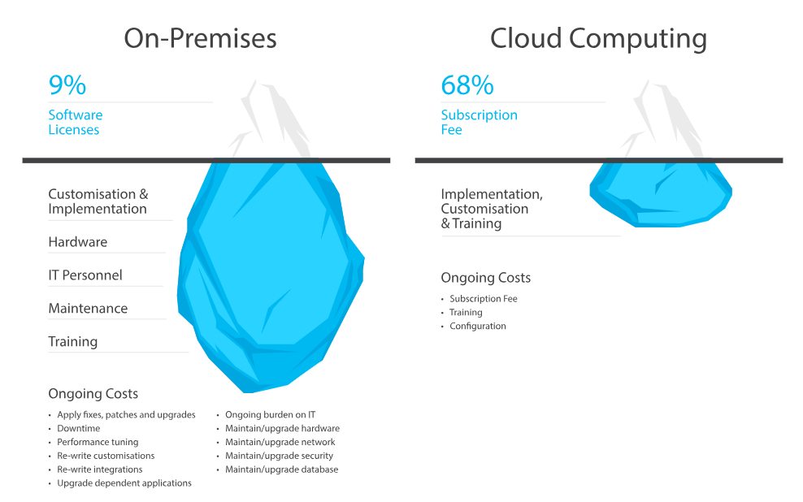
Why Cloud?

Slide 7
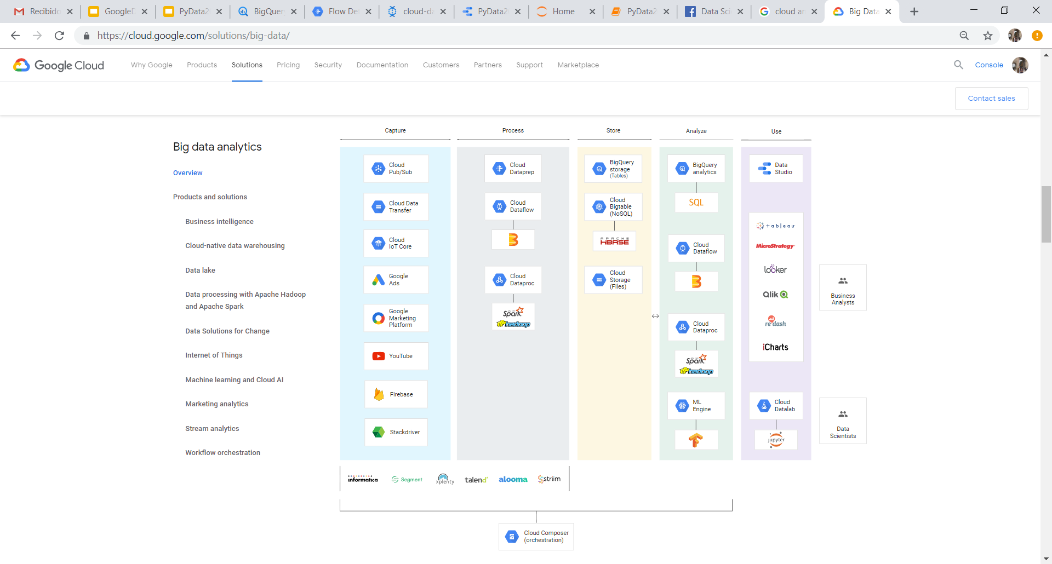
GCP Big Data platform

Slide 8

Let’s do it!

Slide 9










GCP Architecture Example
Organización
ETL - Cloud Dataflow
Source 1
Cloud VPN
BigQuery
Cloud Storage
Data Studio
Source 2
Cloud Dataflow

